Slide 1
Quantum Circuit
Learn the basics of quantum computing
不正经讲师：理科宅Hunt

Slide 2
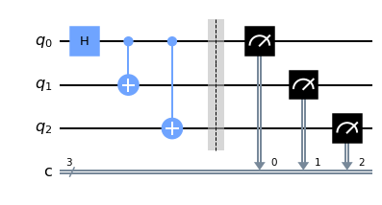
Quantum Circuits (量子线路)
Quantum circuits is a graphical representation of operations on qubits.
There are 2 kinds of operations: Quantum logic gates and measurements.
Chronological order is from left to right.
qubits
gates
measurements

Slide 3

Qubits
We talked about qubits in last lecture already.
Computational basis:$\left|0\right\rangle ={\left[1,0\right]}^{T}, \left|1\right\rangle ={\left[0,1\right]}^{T}$
There are other basis, such as Bell Basis for quantum teleportation.

Slide 4
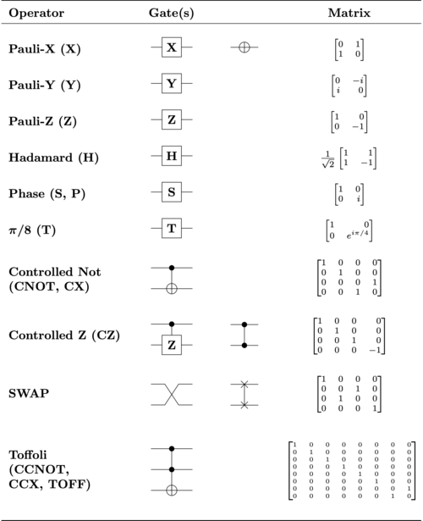
Quantum logic gates (量子逻辑门)
Quantum logic gates are unitary operators.
Common quantum gates: Pauli matrices, Hadamard gates, CNOT …

Slide 5

Example – Pauli X matrix
Apply Pauli X matrix to $|0⟩$ and $|1⟩$, what do we get?
$$X\left|0\right\rangle =\left[\begin{matrix}0 & 1 \\ 1 & 0\end{matrix}\right]\left[\begin{aligned}1 \\ 0\end{aligned}\right]=\left[\begin{aligned}0 \\ 1\end{aligned}\right]=|1⟩$$
$$X\left|1\right\rangle =\left[\begin{matrix}0 & 1 \\ 1 & 0\end{matrix}\right]\left[\begin{aligned}0 \\ 1\end{aligned}\right]=\left[\begin{aligned}1 \\ 0\end{aligned}\right]=|0⟩$$
Sometimes, Pauli X matrix is called NOT gate.

Slide 6

Example – Hadamard gate
Apply Hadamard gate to $|0⟩$ and $|1⟩$, what do we get?
$$H\left|0\right\rangle =\frac{1}{\sqrt{2}}\left[\begin{matrix}1 & 1 \\ 1 & −1\end{matrix}\right]\left[\begin{aligned}1 \\ 0\end{aligned}\right]=\frac{1}{\sqrt{2}}\left[\begin{aligned}1 \\ 1\end{aligned}\right]=\frac{\left|0\right\rangle +|1⟩}{\sqrt{2}}$$
$$H\left|1\right\rangle =\frac{1}{\sqrt{2}}\left[\begin{matrix}1 & 1 \\ 1 & −1\end{matrix}\right]\left[\begin{aligned}0 \\ 1\end{aligned}\right]=\frac{1}{\sqrt{2}}\left[\begin{aligned}1 \\ −1\end{aligned}\right]=\frac{\left|0\right\rangle −|1⟩}{\sqrt{2}}$$
Hadamard gate is used to generate superposition states.

Slide 7
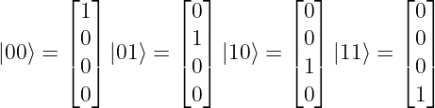
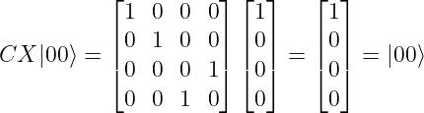

Example – Controlled NOT gate (CNOT)
Apply CNOT gate to $\left|00\right\rangle ,\left|01\right\rangle ,\left|10\right\rangle$ and $|11⟩$, what do we get?
Using tensor product, we have

Slide 8














Example – Controlled NOT gate (CNOT)
If the first bit is 0, do nothing; If the first bit is 1, flip the second bit.
$$|0⟩$$
$$|0⟩$$
$$|0⟩$$
$$|0⟩$$
$$|1⟩$$
$$|1⟩$$
$$|1⟩$$
$$|1⟩$$
$$|0⟩$$
$$|0⟩$$
$$|1⟩$$
$$|1⟩$$
$$|0⟩$$
$$|1⟩$$
$$|1⟩$$
$$|0⟩$$

Slide 9
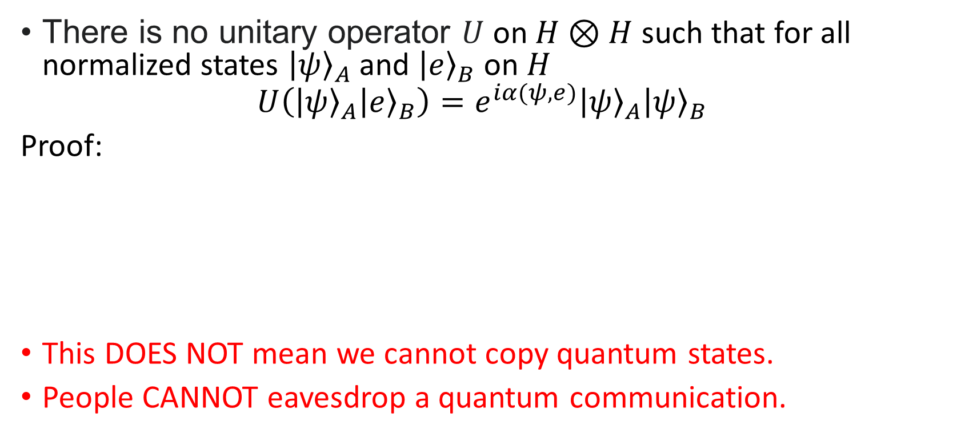

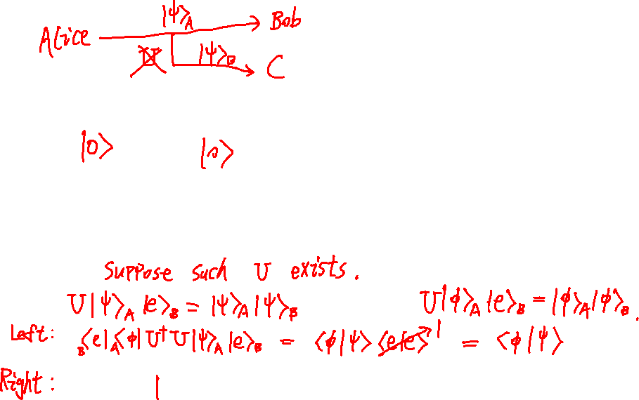
No-cloning theorem (不可克隆原理)
There is no unitary operator $U$ on $H⊗H$ such that for all normalized states ${\left|ψ\right\rangle }_{A}$ and ${\left|e\right\rangle }_{B}$ on $H$
$$U\left({\left|ψ\right\rangle }_{A}{\left|e\right\rangle }_{B}\right)=e^{iα(ψ,e)}{\left|ψ\right\rangle }_{A}{\left|ψ\right\rangle }_{B}$$
Proof:
This DOES NOT mean we cannot copy quantum states.
People CANNOT eavesdrop a quantum communication.

Slide 10
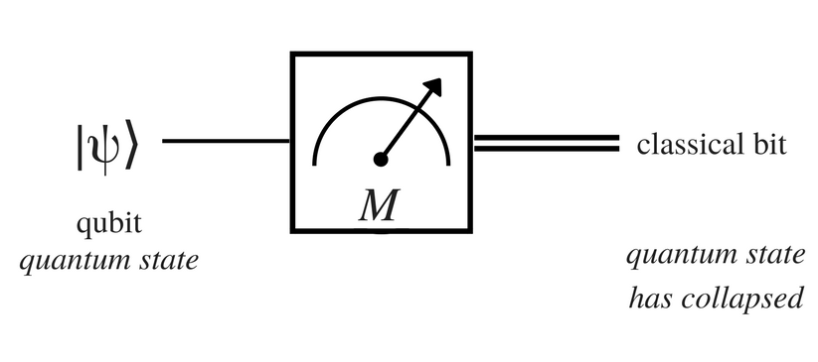
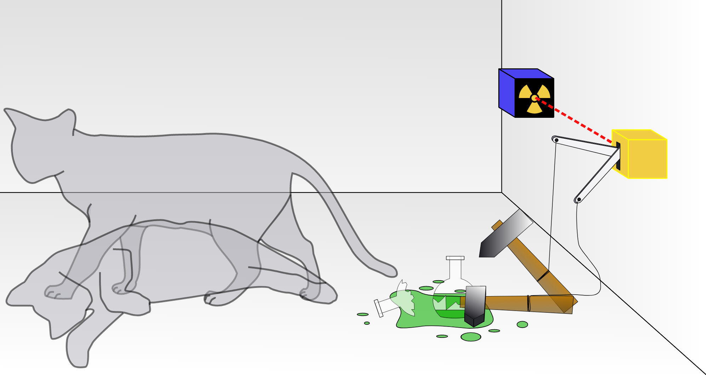

Measurement (测量)
You will only know the state of Schrödinger's cat if you open the box (measure).
Qubit’s wave function will collapse to a certain state ($|0⟩$ or $|1⟩$) when you measure it.
To get the final results, you need to measure qubits!

Slide 11

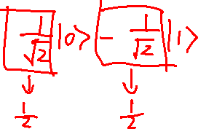
Example
What do you measure after a Hadamard gate is applied to $\left|1\right\rangle$?
$$H\left|1\right\rangle =\frac{\left|0\right\rangle −|1⟩}{\sqrt{2}}$$
By reading the coefficients, we know there is 50% chance we get $|0⟩$ and 50% change to get $|1⟩$.

Slide 12
Summary
Quantum circuits consists of:
Quantum logical gates
Measurements (usually at the end)
No-cloning theorem

